Slide 1

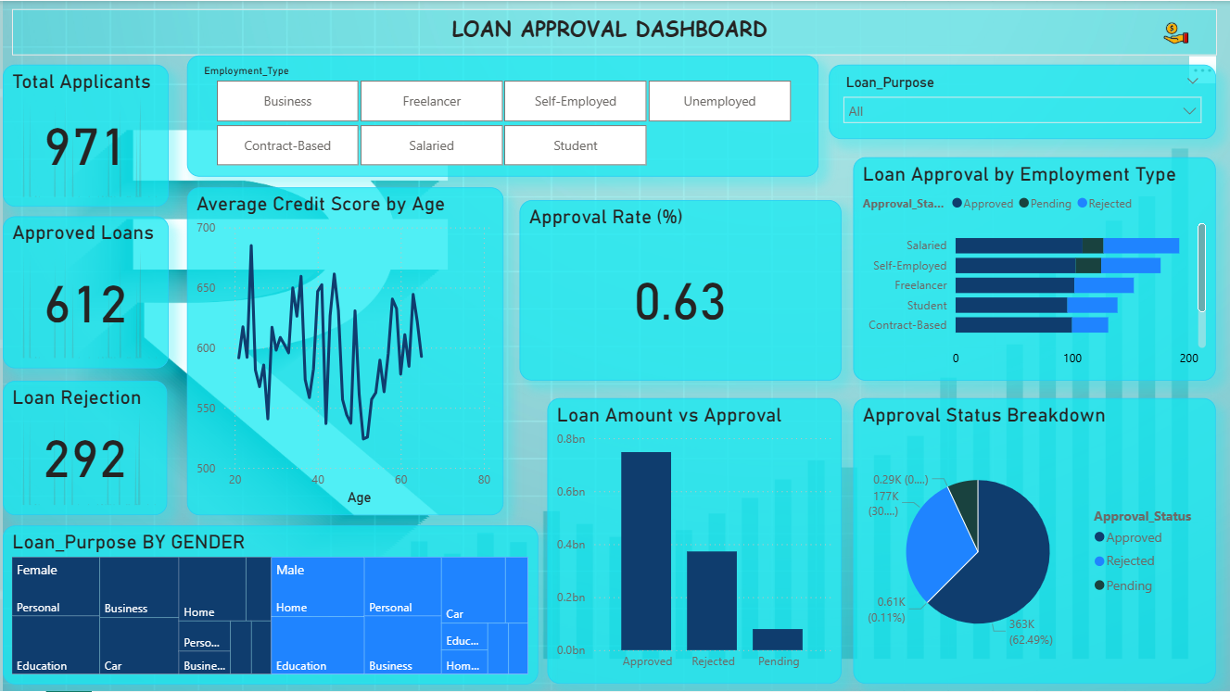
Loan Approval Dashboard Overview
This presentation explains the components and insights of the Loan Approval Dashboard.

Slide 2

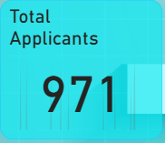
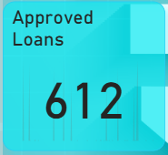
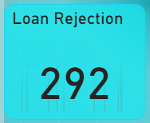
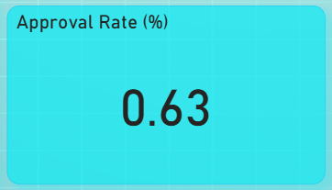
What is a Loan Approval Dashboard?
A Loan Approval Dashboard visualizes key metrics related to loan applications, approvals, rejections, and applicant demographics.
💹Key Metrics Summary
This slide discusses the main KPIs: Total Applicants, Approved Loans, Rejected Loans, and Approval Rate.

Slide 3
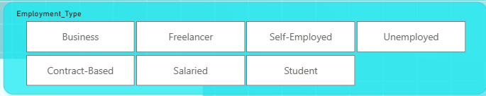

Slicer
The Loan Purpose slicer filters the dashboard based on the reason for taking a loan.
Common categories include:
Personal
Business
Home
Car
Education
Medical
The Employment Type slicer helps users filter the entire dashboard based on the applicant’s job category.
It includes seven categories:
Business
Freelancer
Self-Employed
Unemployed
Contract-Based
Salaried
Student

Slide 4
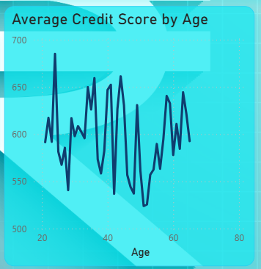
Average Credit Score by Age
This visual displays the relationship between the applicant’s age and their average credit score.
It uses a line chart to show how credit scores vary as age increases.
Key Insights:
Younger applicants (age 20–30) often show more fluctuations in credit score.
Middle-age applicants (30–50) generally maintain more stable and higher credit scores.
Credit scores may drop slightly after age 55 in some cases, indicating less borrowing activity or different financial behavior.

Slide 5
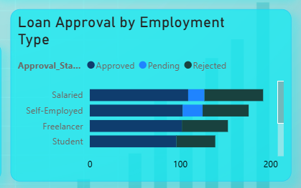
Loan Approval by Employment Type
This stacked horizontal bar chart displays how loan approval status varies across different employment groups:
Salaried
Self-Employed
Freelancer
Student
Each bar is split into:
Approved (dark blue)
Pending (light blue)
Rejected (cyan/green)
Why This Visual Is Important:
Helps understand how employment affects loan approval decisions.
Useful for banks to target low-risk groups and support high-potential groups.

Slide 6
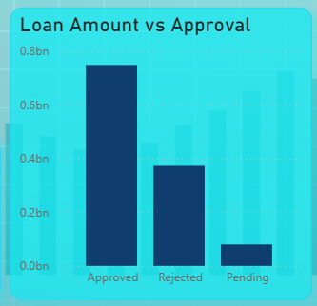
Loan Amount vs Approval
This bar chart compares the total loan amount for each approval status category:
Approved
Rejected
Pending
Key Insights:
The highest loan amount is in the Approved category, showing strong creditworthy applicants.
A significant amount also falls under Rejected, indicating many applications fail due to low credit score or high risk.
Why This Is Important:
Helps understand how much total loan value the bank actually disburses.
Shows potential risk exposure in rejected applications.

Slide 7
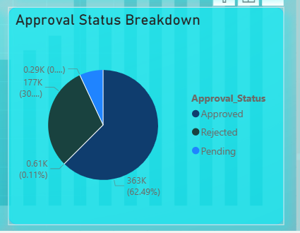
Approval Status Breakdown
This pie chart displays the distribution of loan applications across the three approval statuses:
Approved
Rejected
Pending
Each segment shows both:
The number of applications
The percentage share
Key Insights:
Approved (largest segment – around 62%)
This indicates that a majority of applicants meet the lending criteria such as adequate credit score, stable income, or low debt ratio.
Rejected (second largest – around 30%)
A considerable portion of applications are rejected due to reasons like low credit score, incomplete documents, or high loan risk.
Why This Visual Is Important:
It provides a clear overall picture of loan application decisions.
Helps management monitor the approval effectiveness of the loan process.

Slide 8


